Slide 1
Principles of Economics
Topic 3 (Chapter 28)
Unemployment

Slide 2
Macroeconomic Instability
Economic Growth
Business Cycle
Unemployment
Inflation

Slide 3
Economic Growth
Economists define and measure economic growth as either:
An increase in real GDP occurring over some time period
An increase in real GDP per capita occurring over some time period.

Slide 4
Economic Growth
If real GDP was $ 200 billion in some country last year and $ 210 billion this year, the rate of growth would be 5 percent.
Rule of 70:
Approximate number of years required to double real GDP = (70 / annual percentage rate of growth)

Slide 5
The Business Cycle
The term business cycle refers to alternating rises and declines in the level of economic activity.
Decline in real GDP leads to significant increases in unemployment.
Rapid economic growth has been marred by rapid inflation.

Slide 6
The Business Cycle
The term business cycle refers to alternating rises and declines in the level of economic activity.
Decline in real GDP leads to significant increases in unemployment.
Rapid economic growth has been marred by rapid inflation.

Slide 7
The Business Cycle
Growth Trend
Level of real output
Peak
Recovery
Recession
Trough
Time

Slide 8
Phases of the Business Cycle
Peak:
→ at a peak business activity has reached a temporary maximum.
→ the economy is at full employment.
→ very close to full productivity.
The price level is likely to rise during this phase.

Slide 9
Phases of the Business Cycle
Recession:
→ a period of decline in total output, income, employment, and trade.
→ wide spread contraction of business activity.
The price level is likely to fall.

Slide 10
Phases of the Business Cycle
Trough:
→ output and employment bottom out at their lowest levels.
→ the trough phase may be either short lived or quite long.

Slide 11
Phases of the Business Cycle
Recovery:
→ in the recovery phase, output and employment rise toward full employment.
The price level may begin to rise before full employment and full capacity production return.

Slide 12
Unemployment
The labor force consists of people who are able and willing to work.
Both those who are employed and those who are unemployed but actively seeking work are counted as being in the labor force.

Slide 13
BLS divides population into 3 groups:
  Employed: paid employees, self-employed,
  and unpaid workers in a family business
  Unemployed: people who were available and not working but who have looked for work during previous 4 weeks
  Not in the labor force: those who do not fit either any of the above two categories. i.e. full-time student, homemaker, or retiree
The labor force is the total # of workers, including the employed and unemployed.

Slide 14
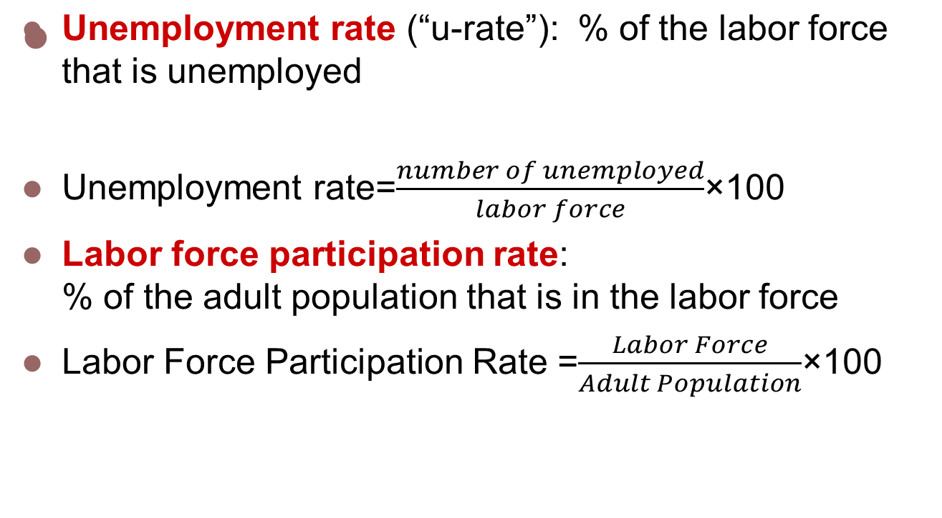
Labor Force Statistics

Slide 15
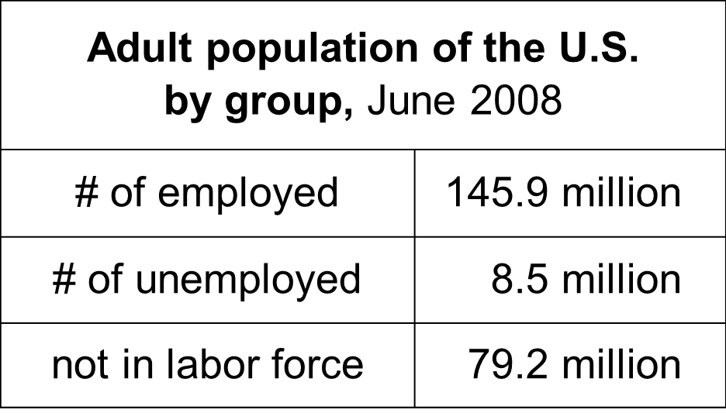
Compute the labor force, u-rate, adult population, and labor force participation rate using this data:

Slide 16
Answers
Labor force = employed + unemployed
= 145.9 + 8.5
= 154.4 million
U-rate = 100 x (unemployed)/(labor force)
= 100 x 8.5/154.4
= 5.5%

Slide 17
Answers
Population = labor force + not in labor force
= 154.4 + 79.2
= 233.6
LF partic. rate = 100 x (labor force)/(population)
= 100 x 154.4/233.6
= 66.1%

Slide 18
Unemployment
The unemployment rate is the percentage of the labor force unemployed:
Unemployment rate= (unemployed / labor force) X 100

Slide 19
Types of Unemployment
There are three types of unemployment:
→ Frictional Unemployment
→ Structural Unemployment
→ Cyclical Unemployment

Slide 20
Frictional Unemployment
Frictional unemployment consisting of search unemployment and wait unemployment.
The word frictional implies that the labor market does not operate perfectly in matching workers and jobs.

Slide 21
Structural Unemployment
Structural unemployment results because the composition of the labor force does not respond immediately or completely to the new structure of job opportunities.
Structurally unemployed workers find it hard to obtain new jobs without retraining, gaining additional education, or relocating.

Slide 22
Cyclical Unemployment
Cyclical unemployment is caused by a decline in total spending and is likely to occur in the recession phase of the business cycle.

Slide 23
Types of Inflation
Inflation: persisting rise in the price level
Two types of inflation:
→ Demand-Pull Inflation
→ Cost-Push Inflation

Slide 24
Demand-Pull & Cost-Push Inflation
Demand Pull Inflation: Changes in the price level are caused by an excess of total spending beyond the economy’s capacity to produce.
Cost-Push Inflation: Rising prices in terms of factors that raise per-unit production cost at each level of spending.

